Slide 1
Student Alcohol Consumption
Group B:
Alex Balter
Nash Delcamp
Rayden Soriano
MAR653 - Marketing Analytics
SPRING 2019

Slide 2

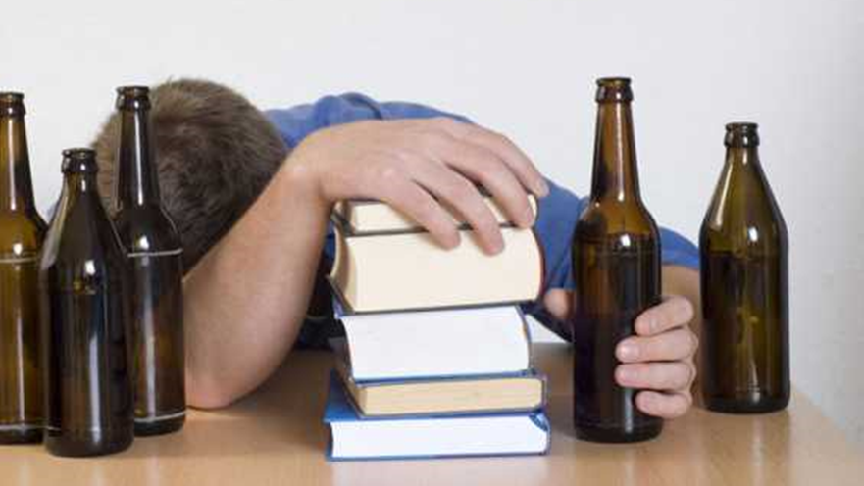
Overview
A survey dataset which includes information regarding student alcohol consumption.
The dataset consists of many family and lifestyle related variables including weekday and weekend alcohol intake (scale from 1-5). Also included are variables related to school performance.

Slide 3
Introduction to the Data
guardian | school | sex | address | Famsize | Pstatus | activities | internet | romantic
Father 219 | GP 699 | F 541 | Rural 268 | >3 677 | Apart 114 | No 482 | No 204 | No 616
Mother 671 | MS 260 | M 418 | Urban 691 | <3 282 | Together 845 | Yes 77 | Yes 755 | Yes 343
Other 69
Key Provided Calculated |  | age | traveltime | studytime | failures | famrel | freetime | goout | health | absences | G1.final | G2.final | G3.final | Dalc | Walc | Talc
 | Min | 15.0 | 1.0 | 1.0 | 0.0 | 1.0 | 1.0 | 1.0 | 1.0 | 0.0 | 0.0 | 0.0 | 0.0 | 1.0 | 1.0 | 1.0
 | Mean | 16.8 | 1.6 | 2.0 | 0.3 | 3.9 | 3.2 | 3.2 | 3.5 | 4.7 | 11.1 | 11.1 | 11.2 | 1.5 | 2.3 | 2.1
 | Max | 22.0 | 4.0 | 4.0 | 3.0 | 5.0 | 5.0 | 5.0 | 5.0 | 75.0 | 19.0 | 19.0 | 20.0 | 5.0 | 5.0 | 5.0

Slide 4
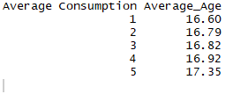
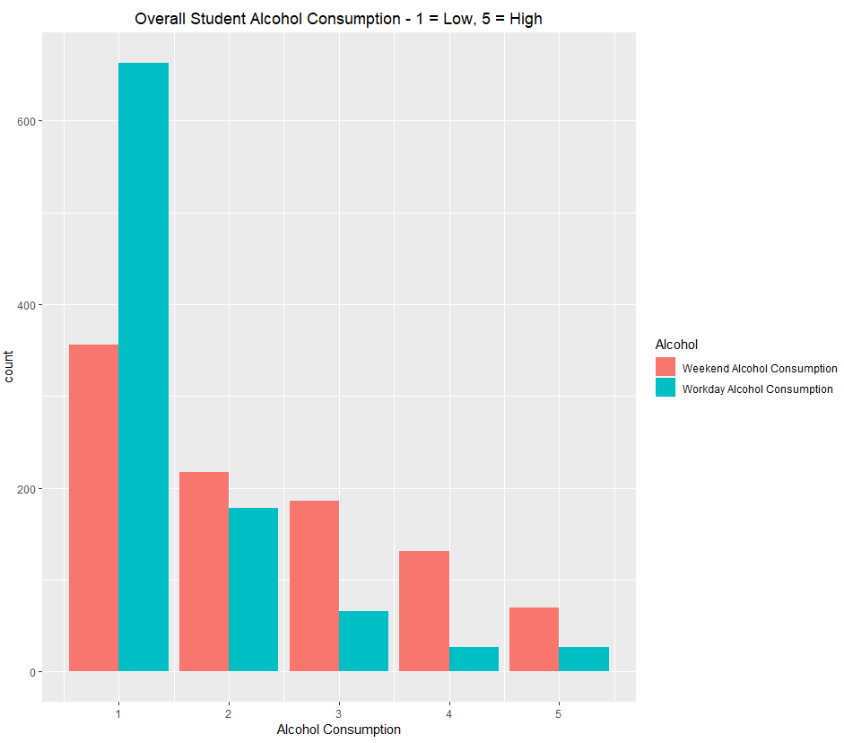
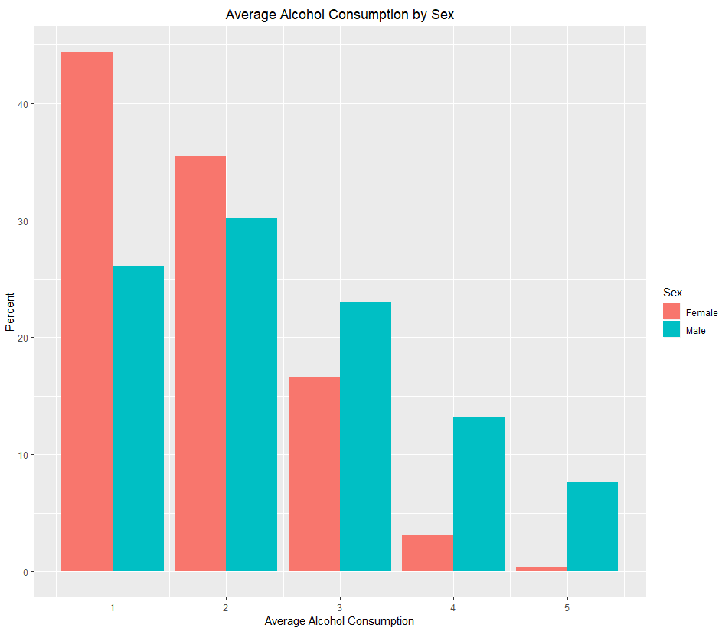

Summary Statistics
Student Alcohol Consumption was rated on a scale from 1 to 5.
1 = Low
5 = High
Overall
In general, older students consumed more alcohol
By Percentage, males consumed more alcohol
Most alcohol consumption takes place on weekends
Going Out with Friends had a large impact

Slide 5
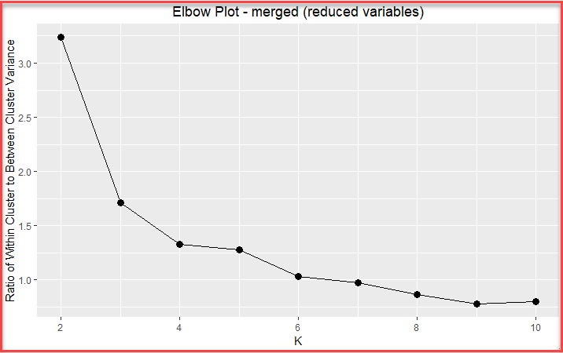
K-Means Clusters
Cluster | Talc | Count | Talc_Center | Cumulative | ratioCluster | ratioTotal
1 | 1 | 116 | 1.49 | 116 | 0.51 | 0.12
1 | 2 | 111 | 1.49 | 227 | 0.49 | 0.12
2 | 3 | 101 | 3.43 | 101 | 0.67 | 0.11
2 | 4 | 33 | 3.43 | 134 | 0.22 | 0.03
2 | 5 | 16 | 3.43 | 150 | 0.11 | 0.02
3 | 1 | 233 | 1.47 | 233 | 0.53 | 0.24
3 | 2 | 207 | 1.47 | 440 | 0.47 | 0.22
4 | 3 | 85 | 3.53 | 85 | 0.60 | 0.09
4 | 4 | 39 | 3.53 | 124 | 0.27 | 0.04
4 | 5 | 18 | 3.53 | 142 | 0.13 | 0.02
4 clusters chosen

Slide 6
K-Means Cluster Centers
Cluster | sex | address | famsize | Pstatus | studytime | romantic | G1.final | G2.final | G3.final | Talc
1 | 1.30 | 1.64 | 1.26 | 1.87 | 1.89 | 1.43 | 2.04 | 1.93 | 1.93 | 1.49
2 | 1.53 | 1.71 | 1.40 | 1.85 | 1.83 | 1.32 | 2.99 | 3.12 | 3.16 | 3.43
3 | 1.38 | 1.78 | 1.28 | 1.88 | 2.15 | 1.34 | 3.07 | 3.14 | 3.22 | 1.47
4 | 1.73 | 1.66 | 1.28 | 1.92 | 1.61 | 1.35 | 2.03 | 1.95 | 1.94 | 3.53
Cluster 1: More female, slightly more urban, larger families, study an average amount, below average grades, and drink very little.
Cluster 2: Even sex split, more urban, slightly larger families, study an average amount of time, have average-above average grades, and drink a lot.
Cluster 3: More female, much more urban, larger families, study an above average amount, have above average grades, and drink very little.
Cluster 4: More male, slightly more urban, larger families, study a below average amount, have below average grades, and drink a lot.
Clusters 1 & 3 have similar alcohol consumption (low), but Cluster 1 has much lower grades.
Clusters 2 & 4 have similar alcohol consumption (high), but Cluster 4 has much lower grades and is more male.

Slide 7
Linear Model – Predict Final Grade
Variable | Coefficient | P-value | Significance
Intercept | 10.14 | <2e-16 | ***
schoolMS | -0.61 | 0.008 | **
famsizeLE3 | 0.37 | 0.090 | .
Fedu | 0.27 | 0.005 | **
studytime | 0.42 | 0.001 | **
failures | -1.45 | <2e-16 | ***
schoolsupyes | -1.40 | 1.11e-05 | ***
famsupyes | -0.37 | 0.083 | .
higheryes | 1.84 | 4.87e-07 | ***
health | -0.13 | 0.066 | .
paid.allyes | -0.69 | 0.009 | **
Talc | -0.30 | 0.002 | **
Adjusted R-squared: 0.2547
RMSE of test data: 2.92
SSE of test data: 1619.2
𝐺.𝑓𝑖𝑛𝑎𝑙 = 10.14−0.61∙𝑠𝑐ℎ𝑜𝑜𝑙𝑀𝑆+0.37∙𝑓𝑎𝑚𝑠𝑖𝑧𝑒𝐿𝐸3+0.27∙𝐹𝑒𝑑𝑢+0.42∙𝑠𝑡𝑢𝑑𝑦𝑡𝑖𝑚𝑒−1.45∙𝑓𝑎𝑖𝑙𝑢𝑟𝑒𝑠−1.40∙𝑠𝑐ℎ𝑜𝑜𝑙𝑠𝑢𝑝𝑦𝑒𝑠− 0.37∙𝑓𝑎𝑚𝑠𝑢𝑝𝑦𝑒𝑠+1.84∙ℎ𝑖𝑔ℎ𝑒𝑟𝑦𝑒𝑠−0.13∙ℎ𝑒𝑎𝑙𝑡ℎ−0.69∙𝑝𝑎𝑖𝑑.𝑎𝑙𝑙𝑦𝑒𝑠−0.30∙𝑇𝑎𝑙𝑐

Slide 8
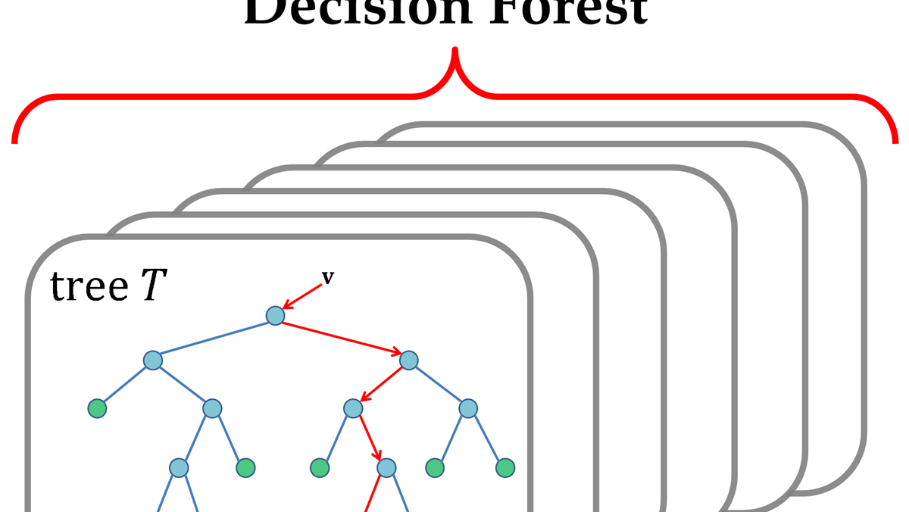
Random Forest Model – Predict Final Grade
Obtained slightly better accuracy than the linear model due to the tree based model approach
Adjusted R-squared: 0.3311
RMSE of test data: 2.69
SSE of test data: 1375.54
This Photo by Unknown Author is licensed under CC BY

Slide 9
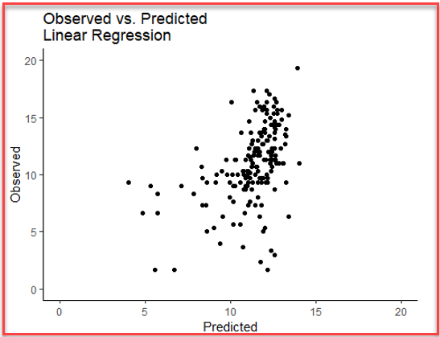
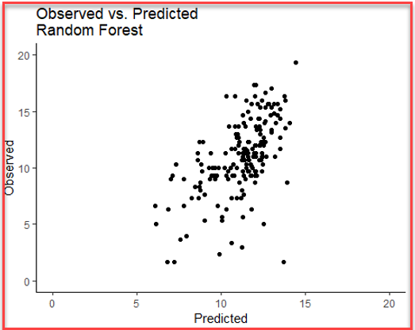
Comparison of Linear Regression and Random Forest Models
Variable | Overall
failures | 100.00
higher | 49.47
Medu | 31.94
studytime | 25.04
Talc | 18.29
Fedu | 18.22
por | 17.48
school | 11.35
reason | 10.72
Mjob | 8.83
schoolsup | 6.89
goout | 6.72
internet | 5.85
address | 5.76
age | 5.57
traveltime | 5.51
famsize | 3.83
famrel | 3.70
absences | 3.64
health | 3.49
freetime | 2.52
romantic | 2.50
nursery | 2.35
guardian | 1.81
paid.all | 1.23
Fjob | 1.09
sex | 0.59
activities | 0.43
famsup | 0.00
Variable | Importance
failures | 100.00
higheryes | 44.41
schoolsupyes | 35.85
studytime | 20.60
Talc | 18.98
Fedu | 15.08
schoolMS | 12.58
paid.allyes | 12.08
health | 1.90
famsupyes | 0.53
famsizeLE3 | 0.00

Slide 10
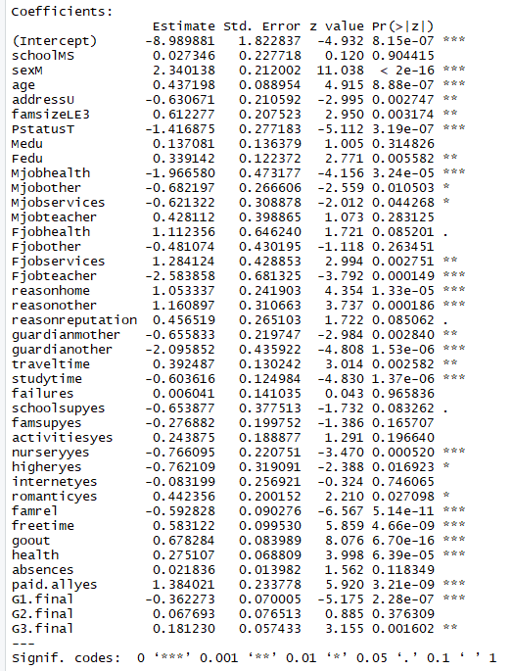

Logistic Regression – Initial Model
Can we predict whether a student has the potential for Alcohol Abuse?
Data Process
“Alcoholic” was defined as a rating of 4 or 5 on the survey scale
This yielded 853 Non-Alcoholics and 106 Potential Alcoholics
Training and Testing Data were created with an 80% - 20% split
A split was done to maintain the proportions of Non-Alcoholics and Alcoholics within both datasets
“Upsampling” was performed on training data to correct class imbalance.
Initial Results 77% Accuracy

Slide 11
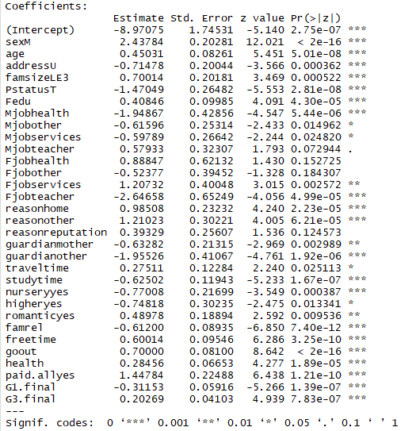

Logistic Regression – Final Model
Insignificant variables were removed
Attr. | Coef. | Finding
SexM | 2.438 | Being Male increases chances for alcohol abuse
PstatusT | -1.470 | Parents still living together decreases chances for alcoholism
Mjobhealth | -1.949 | A mother with a job in the health care field decreases chances for alcoholism
famrel | -0.612 | A quality family relationship decreases chances for alcohol abuse
goout | 0.7 | Going out a lot with friends increases chances for alcohol abuse
The model has a decent sensitivity (identifying true positives), but also has a high false positive rate.
This trade-off may be preferable if being used to identify children prone to alcohol abuse for preventative intervention.
Overall Accuracy 78.5%
True Positive rate (83%)
High False Positive rate (65%)

Slide 12
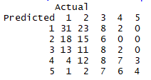

Ordinal Logistic Regression
Ordinal Logistic Regression will attempt to predict the probability of class membership within an ordinal variable. In our case, this was the self-rated Alcohol Consumption on the scale of 1 – 5.
Data Process
Same training and testing data from logistic regression were used.
Training data was “upsampled” in order to balance classes (1, 2, 3, 4, 5).
Insignificant variables were removed from initial model.
Initial results were unattractive, but predicted value was converted using same >= 4 logic…
Leading to very similar results from logistic regression.

Slide 13
Clusters in Logistic Predictions
Logistic | Cluster
Prediction | 1 | 2 | 3 | 4
0 | 0.75 | 0.55 | 0.87 | 0.29
1 | 0.25 | 0.45 | 0.13 | 0.71
Clusters 2 & 4 are the clusters with greater alcohol consumption.
Ordinal Logistic | Cluster
Prediction | 1 | 2 | 3 | 4
0 | 0.84 | 0.58 | 0.85 | 0.32
1 | 0.16 | 0.42 | 0.15 | 0.68

Slide 14

Data Source
UCI Machine Learning. (2017). Student Alcohol Consumption: Social, gender and study data from secondary school students. Retrieved from Kaggle.com: https://www.kaggle.com/uciml/student-alcohol-consumption/home

